Slide 1


The Movies
Factor analysis of successful films.
Produced by:
Ethan Duncan, Andrew Fiegleman, Arisa Nguyen

Slide 2

At a Glance
We set out to understand how certain variables (budget, seasonality, and genre) of a film may correlate with that films success, both financially and critically.
Data
Cleaning / Sampling
Variables
Kaggle
IMDb movies extensive dataset
Web Scraping
The Movie Database (TMDB)
Movies released in the U.S.
Date filtering applied per section.
Invalid or missing data filtered out.
Budget
Seasonality
Genre
Notes:
IMDb (Internet Movie Database) – Online database related to films. Includes data such as release date, budget, imdb score, cast and more.
TBDb (The Movie Database) – Online user editable film database that we used to fill in gaps that were in our original database. Scrapped from the TMDB website using their free API.
Federal Reserve Economic Data (FRED) - for consumer price indexes to calculate our inflation multiplier.
Adjusted the budget and gross income for inflation, and represent all values in 2021 dollars

Slide 3

Budget
Filters:
Limited to movie releases 2000 and onward
Limited to budget >= $300,000
Dropped movies that were missing values for USA gross income, budget, IMDb rating, and vote count
3937 movies left out of 87,000 originally
Initial Hypothesis:
Higher budget movies are more successful than lower budget movies in terms of IMDB rating and overall profitability
Notes:
As Andy said, the first variable we’ll look at is budget.
We hypothesized that higher budget movies will be more successful (in rating and profitability) than lower budget movies.
For this analysis, we:
Limited the dataset to be movies released 2000 and onward
(1) because the IMDB website was fully in-use by the 2000’s and
(2) we have a better understanding of movie culture in the last 20 years.
Limited to dataset to be movies with budgets of $300,000 or more
because our literature research claimed that is the approximate lower limit for proper movies made for the public, rather than student films or projects
This left about 4000 movies left out of original dataset of 87,000
Photo Credit: https://www.google.com/url?sa=i&url=http%3A%2F%2Fjohnalberti.net%2F2015%2F09%2F11%2Fbeyond-the-box-office-what-makes-a-movie-a-success%2F&psig=AOvVaw0lk0FPHrYBFUpAbDZOdDtI&ust=1638761093884000&source=images&cd=vfe&ved=0CAsQjRxqFwoTCMjBufnay_QCFQAAAAAdAAAAABAQ

Slide 4
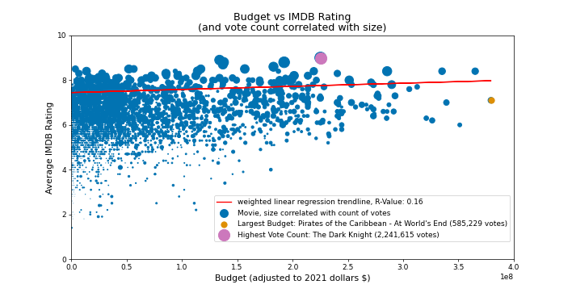
Budget (Ratings x Budget x Vote Count)
Each movie weighted by its number of votes or ratings
Positive but weak correlation between the movie’s budget and IMDb rating with a R-Value of 0.16
Weak correlation indicates that budget might not affect the IMDb rating of the movie
Movies of all types of IMDb ratings can be found across all budget sizes
Notes:
We first started by plotting each movie by its budget and IMDB rating, with the size of each marker correlating with the movie’s total number of vote counts
We then plotted a linear regression trendline, that was weighted by the movie’s vote count
Weighting the movies ensures that relatively unknown movies did not influence the data as much as more well-known movies. For example, a movie with 10,000 votes would be given more weight than a movie with just 100 votes.
We found a weak positive correlation between budget and IMDB rating, indicating that movies of all rating types can be found across all budget sizes (which goes against our original hypothesis)

Slide 5
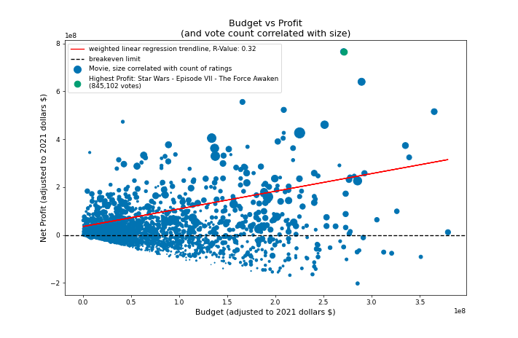
Budget (Profit x Budget x Vote Count)
Each movie weighted by its number of votes or ratings
Strong positive correlation with R-value of 0.32
A movie that has a higher budget is more likely to have a higher profit.
This supports the initial hypothesis that budget affects a movie’s success.
Notes:
Next, we plotted budget against net profit, which was calculated by subtracting budget from net gross income
We found a stronger positive correlation between these two variables
This means that a movies with a higher budget is more likely to have higher profit, and this is in line with our original hypothesis

Slide 6
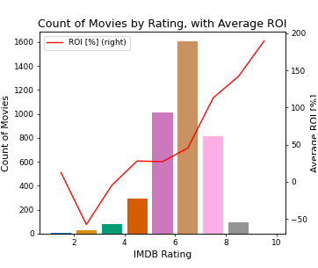
Budget (ROI x Rating)
ROI typically increased with IMDb rating
Movies can be well-received and profitable relative to their budget
“Saving Christmas” was outlier in 1 - 2 ratings range
Rating of 1.4
Budget of $553,846 (2021 dollars)
Income of $3,083,784 (2021 dollars)
ROI of 457%
Notes:
Third, we looked at return on investment, because it’s also important to have a high (ROI) to be considered a profitable, successful movie.
Our graph indicates that despite previously finding profit and budget being strongly correlated, even small-budget movies can be profitable relative to their budget if they are well received by the audience.
Investment = budget
Return = gross income
(return - budget) / budget

Slide 7
Budget (Summary)
Average Values and Count of Movies by Budget Bracket
Strong correlation budget and profits
Weak correlation between budget and IMDb rating
Movies that are well-received can be profitable relative to their budget
Does budget in a movie matter for success? Yes, for magnitude of profit but less so for IMDb ratings and ROI
Budget (2021 dollars $) | Average Profit | Return on Investment | IMDB Rating | Count of Movies
Up to $50,000,000 | $8,257,181 | 71% | 6.1 | 2736
Up to $100,000,000 | $11,758,130 | 16% | 6.2 | 644
Up to $150,000,000 | $11,384,727 | 9% | 6.3 | 280
Up to $200,000,000 | $26,337,512 | 15% | 6.7 | 170
Up to $250,000,000 | $56,599,165 | 26% | 6.8 | 73
Up to $300,000,000 | $129,771,497 | 47% | 7.1 | 25
Up to $350,000,000 | $119,028,058 | 35% | 7.2 | 6
Up to $400,000,000 | $145,417,970 | 40% | 7.2 | 3
Notes:
WHAT DOES THIS ALL MEAN
some correlation between budget and profits
Little correlation between budget and IMDB rating
Budget of a movie matters for magnitude of profit but less so for IMDB ratings and ROI

Slide 8




Seasonality
Filters:
Limited to movie releases 1940 and onward.
Movies that had a released in the United States.
Movies that were missing values for or had invalid USA gross income, movies missing release dates.
43,000 movies left out of 87,000 originally.
Initial Hypothesis:
Summer and holiday months bring in the highest box office, but may not be the indicative of critical success.
Notes:
For seasonality we looked at all movies 1940 or after than had a release in the United States.
We also removed movies with missing or invalid box office figures.
This left us with a usable sample of about half of our original dataset.
Our initial hypothesis was that Summer and Holiday months with bring in the highest box office, but critical success may be more random.

Slide 9
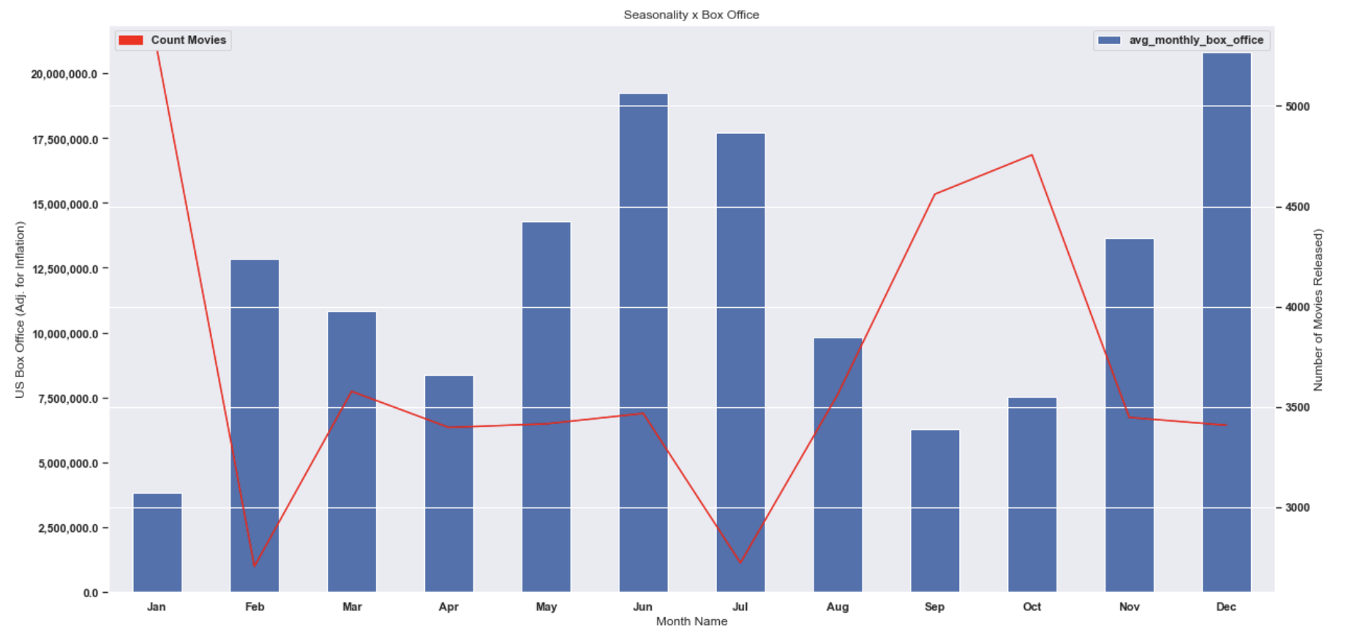
Seasonality (Box Office x Month)
Summer months and holiday months appear to be the strongest with Jun. and Dec. making up 28% of all box office.
Jan., Sept., and Oct., are considered “Dump Months” in the industry, where studios dump their films they expect to fail.
Generally an inverse relationship between lucrative months and movies released in that month.
A film’s success is a function of competitive landscape upon release date.
Notes:
We quickly found that June and December exhibited the most lucrative months, making up about 28% of total yearly box office in the U.S.
Additionally, we observed that certain months appeared to significantly under-perform (specifically January, September and October).
This makes sense if you’re familiar with Dump Month in the film industry, which are months where studios dump their projects they expect to fail or under-perform.
We also noticed an inverse relationship between Box Office and Movie Counts, meaning that months with a lot of films being released tend to have lower average box office

Slide 10
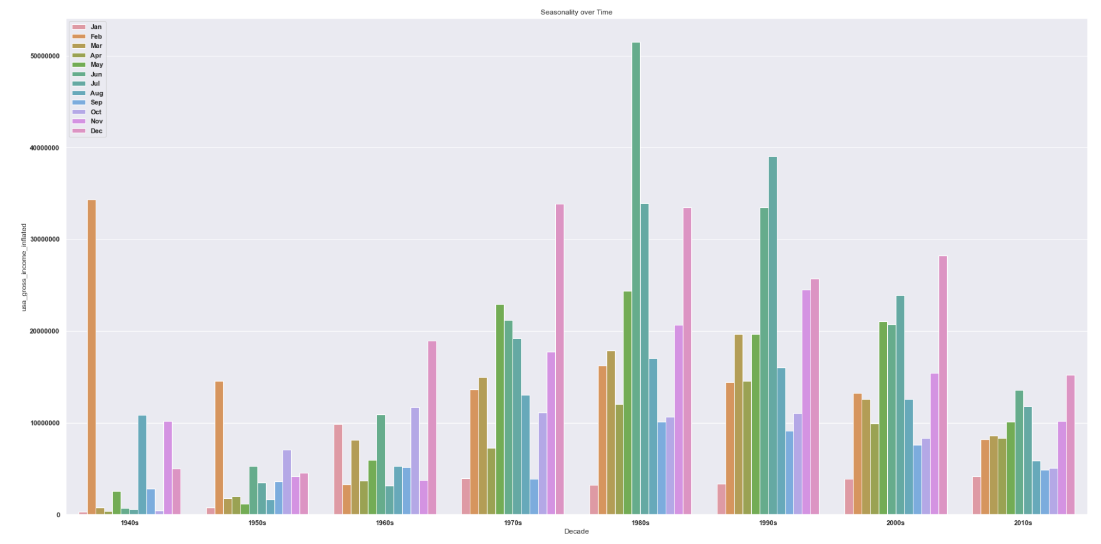
Seasonality (Box Office x Month x Decade)
The most lucrative film months have changed over time, most dramatically with the introduction of ‘Summer Blockbuster’ in the late 1970s / early 1980s.
Before the 1970s, no strong pattern was evident, except that December movies began to over-index.
Today, we have a much clearer picture with the summer months (Jun., Jul.) and holiday months (Nov., Dec.) making up almost half (~48+%) of yearly US box office.
Notes:
In terms of how seasonality has changed over time, we see a shift from a relatively sporadic landscape before 1970 to one that strongly favors the summer and holiday months.
This is largely due to the emergence of the summer blockbuster that was created off the movies like Jaws, Star Wars, and Grease in the 1970s.
Since then, we see strong performance in both of these time periods whereby June and July and November and December make up about half of the U.S. yearly box office

Slide 11
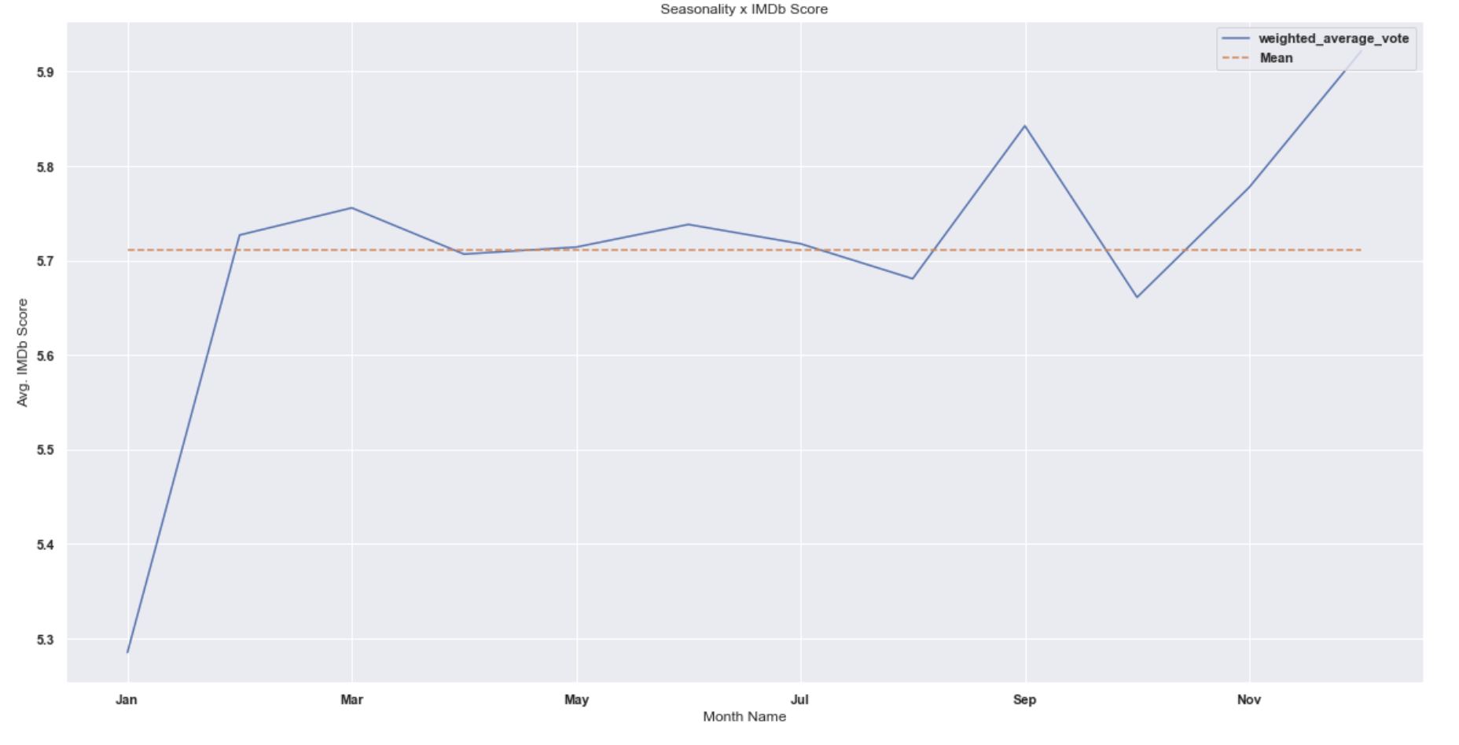
Seasonality (Rating x Month)
Looking at Rating, we find that movies released in January tend to receive the lowest ratings (-7.6%) while those in December tend to receive the highest (+3.9%).
This aligns with our understanding of “Dump Months”.
Additionally, it aligns with many studios’ strategies to release their films they believe to be Oscar contenders closer to the Academy Awards ceremony.
Notes:
In this analysis we immediately see that January performs the worst critically and December performs the best.
This follows our understanding of Dump Months, whereby studios release the films they expect to flop in January.
Similarly, this follows our understanding of how Awards season works in the film industry in that studios tend to release their most quality films closest to the Golden Globes and the Oscars (i.e., December)

Slide 12



Seasonality (Summary)
June and December represent the most lucrative months for the film industry.
This trend started in the 1970s with the introduction of the Summer Blockbuster (Jaws ‘75).
Following our understanding of ‘Dump Months’ films released in January tend to have the lowest IMDb rating while those released just before Oscar season (December) tend to have the highest.
Notes:
Some main learnings here were (1) June and December represent the most lucrative months in the film industry, representing almost a 3rd of all U.S. box office.
We also found that this wasn’t always the case, and that the current seasonal trends have refined themselves over time. Most notably in the 1970s with the emergence of the summer blockbuster.
As we expected, critical acclaim and financial success don’t always match 1 to 1. But for what we know about the film industry, it makes sense that the lowest rated films tend to be in January, while the highest rated films tend to be released just before awards season in December.

Slide 13

Genre
Databases:
IMDb and TMDB (The Movie DataBase)
Filters:
Movies that were released in the United States.
Movies that were missing values for or had invalid USA gross income
No filter on the years; entire database (1894-2020)
48,747 movies left out of 87,000 originally
Initial Hypothesis:
Certain genre (action) movies are more successful than other genres (musical) movies in terms of IMDb rating and overall profitability
Notes:
Photo Credit: https://www.google.com/url?sa=i&url=http%3A%2F%2Fjohnalberti.net%2F2015%2F09%2F11%2Fbeyond-the-box-office-what-makes-a-movie-a-success%2F&psig=AO

Slide 14

Genre (Genre vs. IMDb Rating)
19 genres used from TMDB.
Documentary the highest rating, received an IMDb rating of 6.40/10
Horror, the lowest rating, received an IMDb rating of 4.59/10
Standard deviation: 0.52

Slide 15
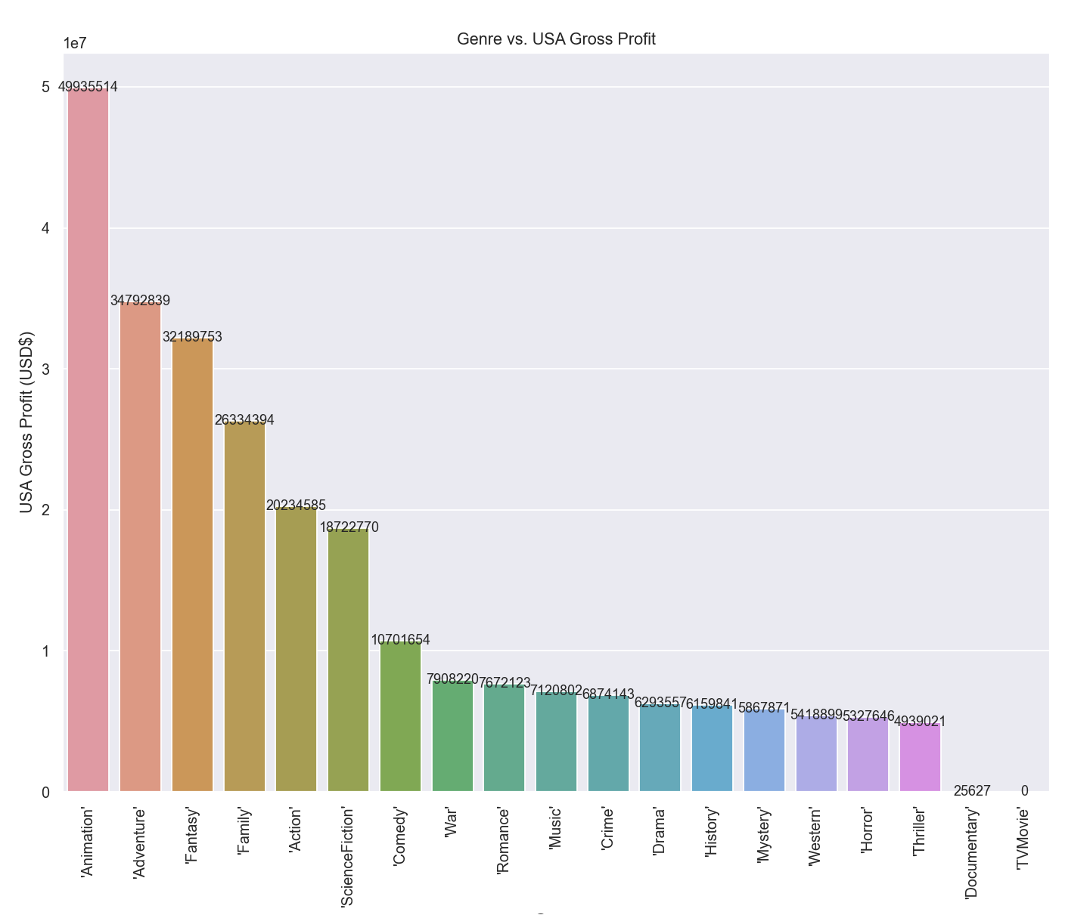
Genre (Genre vs. Gross Profit)
Animation, the highest US gross profit, with a mean profit of $49,935,514
Documentary, the lowest US gross profit, with a mean profit of $25,627 (the TV Movie genre gross profits were not counted in the IMDb database)

Slide 16




Genre (Summary)
Weak/no correlation profits and IMDb rating when using the lens of genre
Certain genre = successful movie?
Genre does not have a clear trend in predicting the success of movies when looking at both metrics of IMDb rating and US gross
Notes:
Genre does not have a clear trend in predicting the success of movies when looking at both metrics of IMDb rating and US gross
Photo Credit: https://bestlifeonline.com/famous-movie-scenes/

Slide 17
Questions?

